Slide 1
Javascript

Slide 2
Content
Tools & Environment Setup
GIT & Github Basics
JavaScript Language Basics
How JavaScript Works Behind the Scenes
JavaScript in the Browser: DOM Manipulation and Events
Project 1 – The Dice Pig Game
Advanced JavaScript: Objects and Functions
Project 2 – The Budget App
Next Generation JavaScript: ES6+ / ES2015+
Asynchronous JavaScript: Promises, Async/Await and AJAX
Project 3 – The Recipe App - Modern JavaScript: Using ES6+, NPM, Babel and Webpack
Deployement on Github Pages.

Slide 3
Content - Detail
Tools & Environment Setup
    Download and Installation
    VS Code Extensions Installation.
GIT & Github Basics
    Git Local Repository.
    Git Remote Repository using Github.com Service.
    GIT using VS Code
    Course Source Code Repository on github.com

Slide 4
JavaScript Language Basics
    Data Types
    Type Conversion
    Variable Mutation
    Alert & Prompt Popup Windows
    Operators
    Decision Making Statements
    Functions
    Arrays
    Objects
    Loops and Iteration

Slide 5
How JavaScript Works Behind the Scenes
    JS Engines – How code is executed
    Execution Context & Execution/Call Stack
    Hoisting
    Scoping/Scope Chain
    this Keyword

Slide 6
JavaScript in the Browser: DOM Manipulation and Events
    Javascript Host Environment
    Browser Host Environment
    What is DOM
    What is BOM
    DOM Tree
Project 1 – The Dice Pig Game

Slide 7
JS Host Environment
The JavaScript language was initially created for web browsers. Since then it has evolved and become a language with many uses and platforms.
JS Platforms/Host Environment:
    Web Browser – Chrome, Firefox etc
    Web Server – NodeJS
    Any Host – Coffee Machine etc.
Each Host environment provides it’s own objects and functions additional to the language core like Web browsers give a means( via DOM and BOM) to control web pages and Node.js provides server-side features.

Slide 8
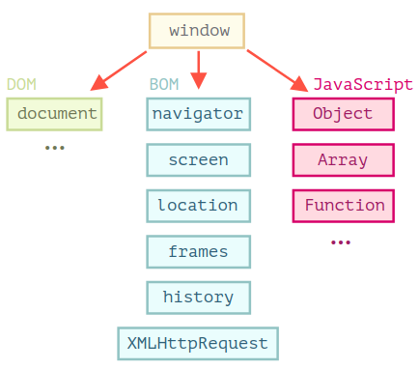
Browser Host Environment
(DOM + BOM + JS)

Slide 9
What is DOM
Document Object Model, or DOM for short, represents a web page content as objects that can be modified.
We can use DOM API in browser to access and modify a web page using Javascript Language.
Similarly we can also use DOM API in Server Side environment to access and modify HTML and XML files using any programming language like Python, Java .Net etc.
DOM Living Standard at https://dom.spec.whatwg.org

Slide 10
What is BOM
The Browser Object Model (BOM) represents additional objects provided by the browser (host environment) for working with everything except the document.
BOM Objects instances:
    Window: It represents the browser's window and is used to do things like window sizing, open, close, move etc.
    Location: The location object can be used to get the current page address (URL) and to redirect the browser to a new page.
    History: The history object contains the browsers history.

Slide 11
    Navigator: The navigator object contains information about the visitor's browser.
    Popup Boxes: Browser has three kind of popup boxes: Alert box, Confirm box, and Prompt box.
    Timing Events: Browser all you to execute your JS code at specified time intervals. Timing methods are setTimeout() & setInterval().
    Cookies: Cookies let you store user information of a web pages in the browser.
    LocalStorage: Localstorage also store a web page information in the browser.
    and many more... :)
For more detail go to : https://www.w3schools.com/js/js_window.asp

Slide 12
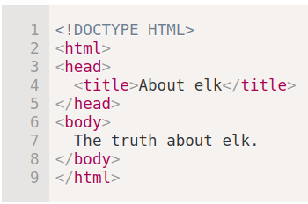
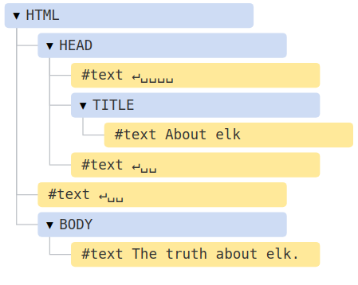
DOM Tree
In DOM every HTML tag is an object. Nested tags are “children” of the enclosing one. The text inside a tag is an object as well.

Slide 13
JavaScript in the Browser: DOM Manipulation and Events
Project 1 – The Dice Pig Game
Advanced JavaScript: Objects and Functions
Project 2 – The Budget App
Next Generation JavaScript: ES6+ / ES2015+
Asynchronous JavaScript: Promises, Async/Await and AJAX
Project 3 – The Recipe App - Modern JavaScript: Using ES6+, Webpack, Babel & NPM
Project Deployment – GitHub/Firebase Hosting

Slide 14
Classwise Schedule
Tools & Environment Setup (Class 1)
GIT & Github Basics. (Class 1)
JavaScript Language Basics (Class 2)
How JavaScript Works Behind the Scenes (Class )
JavaScript in the Browser: DOM Manipulation and Events (Class )
Project 1 – The Dice Pig Game (Class )
Advanced JavaScript: Objects and Functions (Class )
Project 2 – The Budget App (Class )
Next Generation JavaScript: ES6+ / ES2015+ (Class )
Asynchronous JavaScript: Promises, Async/Await and AJAX (Class )
Project 3 – The Recipe App - Modern JavaScript: Using ES6+, NPM, Babel and Webpack (Class )
Deployement on Github Pages. (Class 16)

Slide 15
Tools & Environment Setup
OS: Ubuntu Linux 18.04 LTS
Editor: VS Code
Browser: Chrome
Version Control: GIT
Online Code Repository: Github.com

Slide 16
Download & Installation Links
OS: Ubuntu Linux 18.04 LTS
    Download URL: https://ubuntu.com/download/desktop
    Installation Tutorials
      Ubuntu Installation :
      https://tutorials.ubuntu.com/tutorial/tutorial-install-ubuntu-desktop#0
      Ubuntu Installation as Dual Boot with Windows:
      https://itsfoss.com/install-ubuntu-dual-boot-mode-windows
      Command Line (CLI) Cheetsheet: <TO BE UPDATE From GITHub Link>
Editor: VS Code
    Download URL: https://code.visualstudio.com/download

Slide 17
Browser: Chrome
    Download URL: https://www.google.com/intl/en_sg/chrome/
Version Control: GIT
    Download URL: https://git-scm.com/downloads
    GIT Commands Cheetsheet:
      https://www.atlassian.com/dam/jcr:8132028b-024f-4b6b-953e-e68fcce0c5fa/atlassian-git-cheatsheet.pdf
    GIT Workflow Doc: <TO BE UPDATE from Github Link>
Online Code Repository: Github.com
    Sign Up for Free Github.com Account: https://github.com

Slide 18
VS Code - Extensions
Auto Rename Tag
Live Server
Prettier
Git History
Useful Link: https://www.youtube.com/watch?v=bhu7-5x46BM

Slide 19
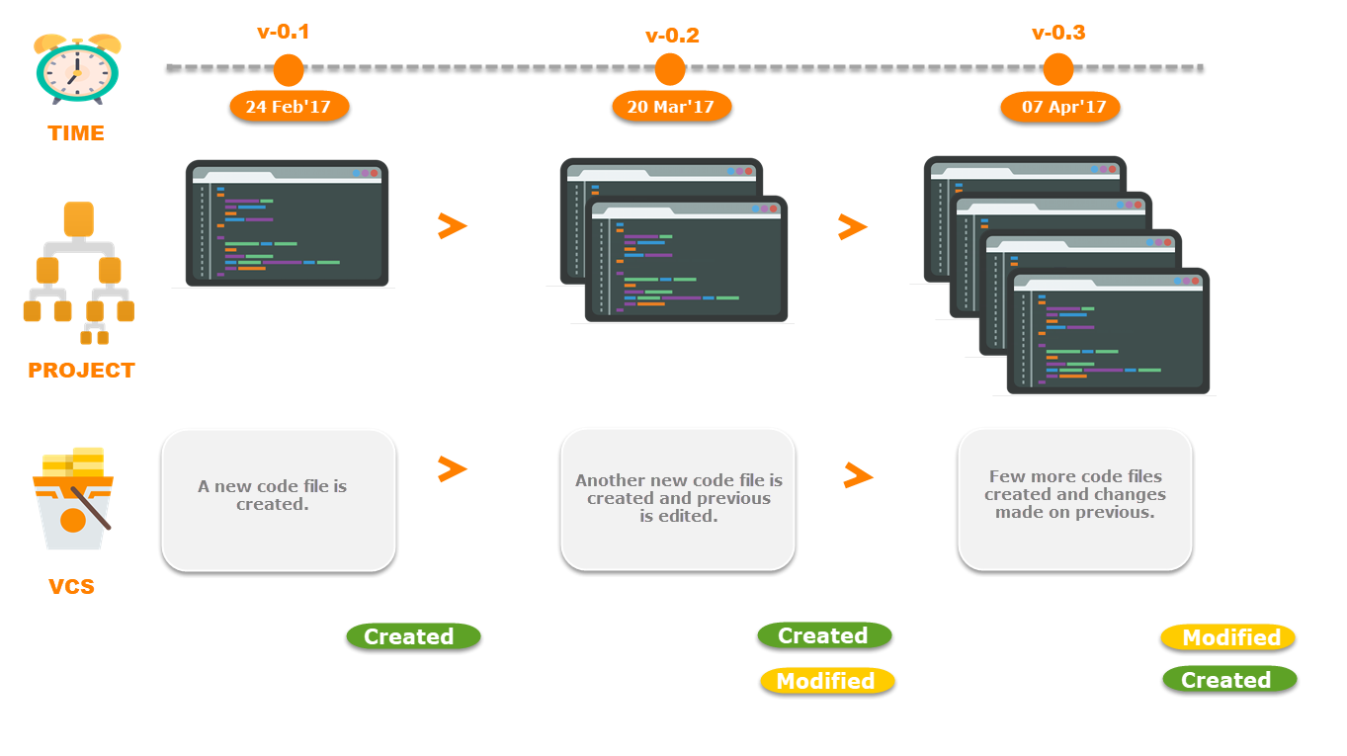
What is Version Controlling System (VCS) ?
It is a software that maintain different versions of a file on computer system.

Slide 20
GIT
Distributed(D) Version Controlling System (VCS).
Developed by Linus Torvalds, who is well known for Linux Kernel.
Most used VCS:
  https://insights.stackoverflow.com/survey/2018#work-_-version-control
GIT is Open Source, hava a look at it’s code here: https://github.com/git/git
Good Read:
  https://guides.github.com/introduction/git-handbook/
  https://speakerdeck.com/schacon/introduction-to-git
  https://www.atlassian.com/git/tutorials/what-is-version-control

Slide 21
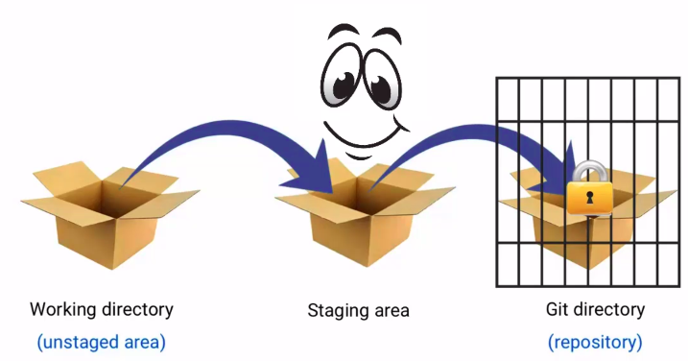
GIT – Working Directory, Stagging area & Repository

Slide 22
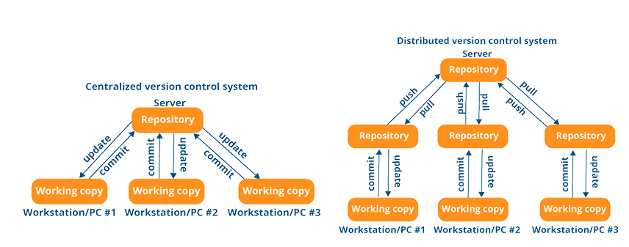
Centralized(C) vs Distributed(D) Version Controlling System (VCS)

Slide 23
Practice
Git – Setup User
Setup Git User Name:
git config –global user.name “your name”
Setup Git User Email:
git config –global user.email “your email”

Slide 24
Practice
Git – Local Repository
Create folder and then create your File(s) or Project(s) in that folder to manage versions.
Initialize Git on to the newly created folder. Note, this is one time activity. ==> git init
Stage changes ==> git add *
See git files status ==> git status
Commit changes locally ==> git commit -m “commit message”
See git files status again ==> git status
See git logs ==> git log
Do some more changes to your file(s) or project(s).
Repeat steps 3 to 8 few more times.

Slide 25
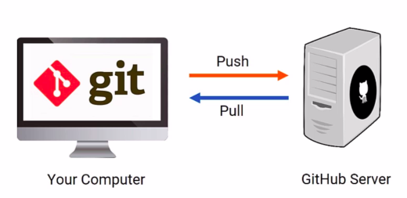
What is Github.com

Slide 26
What is Github.com
Manage Remote/Online Repository using GIT version controlling system.
Free service to host individual developer source code.
Free service for Open Source Software.
Managing largest number of open source software including dotnet core, react, angular, vuejs, npm, vscode, typescript and many more famous softwares.
Similar GIT based hosting Services are:
  Gitlab.com
  Bitbucket.org

Slide 27
Practice
Git – Move Local Repository to Remote on Github.com Service
Create new remote repository on Github.com. Note, One time activity.
Link Local and Remote repository. Note, One time activity ==> git remote add origin < remote repo. Url >
Check repository remote status ==> git remote -v
Push local repository files/projects to remote/online on github server ==> git push -u origin master
Enter git username and password to finally push local changes to remote.
Go to github.com and see your files/projects.

Slide 28
Practice
Git – Create Remote Repo and Clone It
Create new remote repository on Github.com. Note, One time activity.
Clone remote repository on local system. Note, One time activity
==> git clone < remote repo. Url >

Slide 29
Practice
GIT using VS Code
Use default VS Code GIT extension and Terminal to handle git management.
Manage Local GIT Repository.
Move Local Repository to Remote on Github.com Service.
Clone Remote Repository.

Slide 30
Practice
GIT – Create our Learn Javascript Repository
Entire javascript course code will be managed on one single repository which will be remotly hosted on Github.com.
It’s a public repository so clone it for your reference.

Slide 31
Javascript Language Basics
Data Types
Type Conversion
Variable Mutation
Alert & Prompt Popup Windows
Operators
Decision Making Statements
Functions
Arrays
Objects
Loops and Iteration

